Slide 1
DLD
Lecture 15
Magnitude Comparators and Multiplexers
Notes:
Give qualifications of instructors:
DAP
teaching computer architecture at Berkeley since 1977
Co-athor of textbook used in class
Best known for being one of pioneers of RISC
currently author of article on future of microprocessors in SciAm Sept 1995
RY
took 152 as student, TAed 152,instructor in 152
undergrad and grad work at Berkeley
joined NextGen to design fact 80x86 microprocessors
one of architects of UltraSPARC fastest SPARC mper shipping this Fall

Slide 2
Overview
Discussion of two digital building blocks
Magnitude comparators
  Compare two multi-bit binary numbers
  Create a single bit comparator
  Use repetitive pattern
Multiplexers
  Select one out of several bits
  Some inputs used for selection
  Also can be used to implement logic
Notes:
credential:
bring a computer
die photo
wafer
:
This can be an hidden slide. I just want to use this to do my own planning.
I have rearranged Culler’s lecture slides slightly and add more slides. This covers everything he covers in his first lecture (and more) but may
We will save the fun part, “ Levels of Organization,” at the end (so student can stay awake): I will show the internal stricture of the SS10/20.
Notes to Patterson: You may want to edit the slides in your section or add extra slides to taylor your needs.

Slide 3
Comparators
Comparing two binary words is a common operation in computers.
A circuit that compares 2 binary words and indicates whether they are equal is a comparator.
Some comparators interpret their input as signed or unsigned numbers and also indicate an arithmetic relationship (greater or less than) between the words.
These circuits are often called magnitude comparators.
XOR and XNOR gates can be viewed as 1-bit comparators.
Comparator is a combinational logic circuit that compares the magnitudes of two binary quantities to determine which one has the greater magnitude.
In other word, a comparator determines the relationship of two binary quantities.
Notes:
A exclusive−OR gate can be used as a basic comparator.

Slide 4
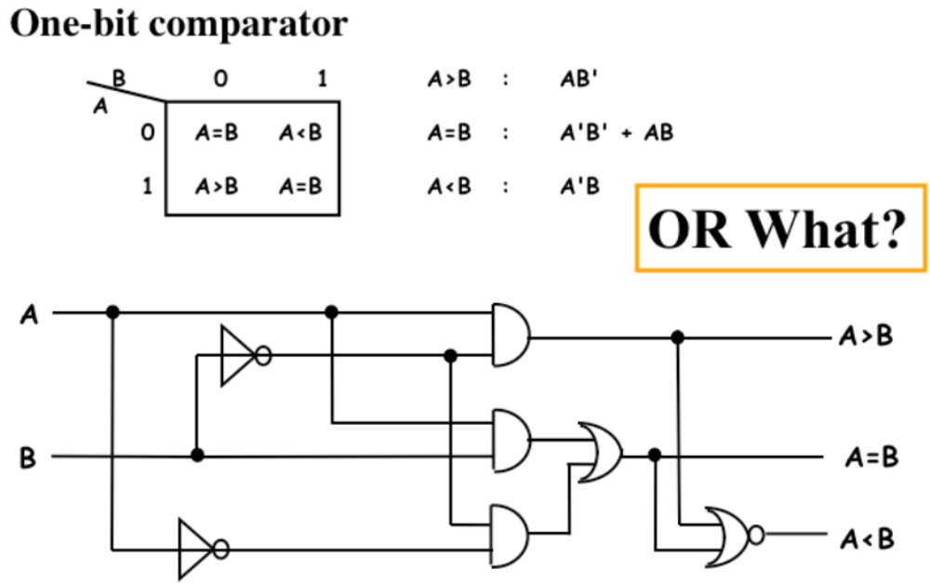
Designing Comparators Functionally

Slide 5
Designing Comparators Functionally
Add an enable line
A
A>B
A=B
B
Enable

Slide 6
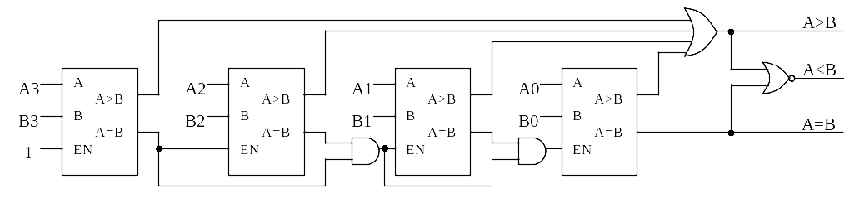
Build a four-bit Comparator (from four one-bit ones)

Slide 7
Comparing 2-bit Numbers - Specification
Let’s design a circuit that compares two 2-bit numbers, A and B. The
circuit should have three outputs:
  G (“Greater”) should be 1 only when A > B
  E (“Equal”) should be 1 only when A = B
  L (“Lesser”) should be 1 only when A < B
Make sure you understand the problem
  Inputs A and B will be 00, 01, 10, or 11 (0, 1, 2 or 3 in decimal)
  For any inputs A and B, exactly one of the three outputs will be 1

Slide 8
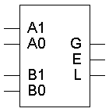
Comparing 2-bit Numbers - Specification
Two 2-bit numbers means a total of four inputs
  We should name each of them
  Let’s say the first number consists of digits A1 and A0 from left to
  right, and the second number is B1 and B0
The problem specifies three outputs: G, E and L

Slide 9
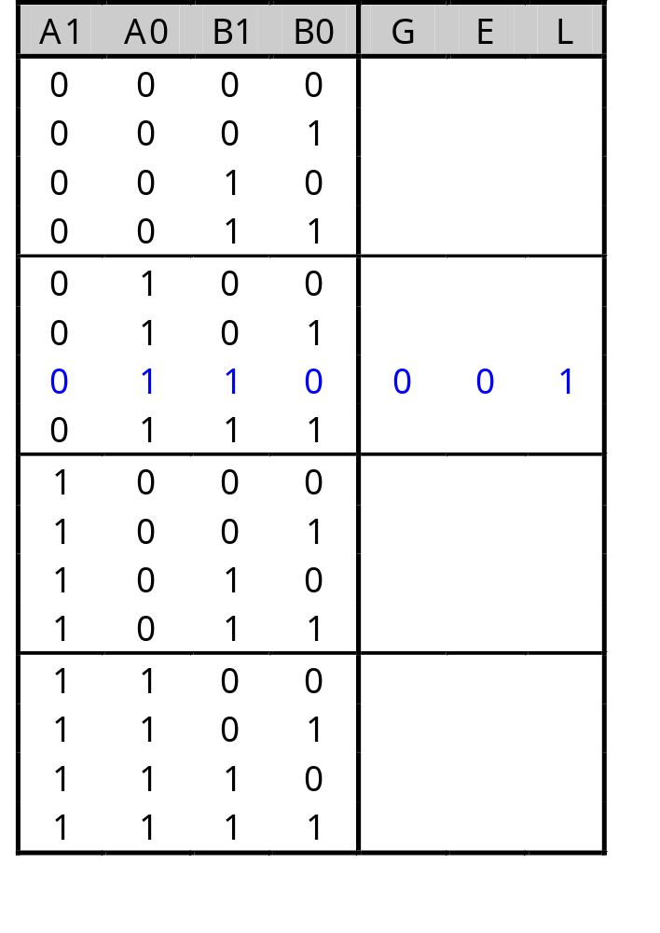
Comparing 2-bit Numbers - Formulation
For this problem, it’s probably easiest to start with a truth table. This way, we can explicitly show the relationship (>, =, <) between inputs
A four-input function has a sixteen-row truth table
It’s usually clearest to put the truth table rows in binary numeric order; in this case, from 0000 to 1111 for A1, A0, B1 and B0
Example: 01 < 10, so the sixth row of the truth table (corresponding to inputs A=01 and B=10) shows that output L=1, while G and E are both 0.

Slide 10
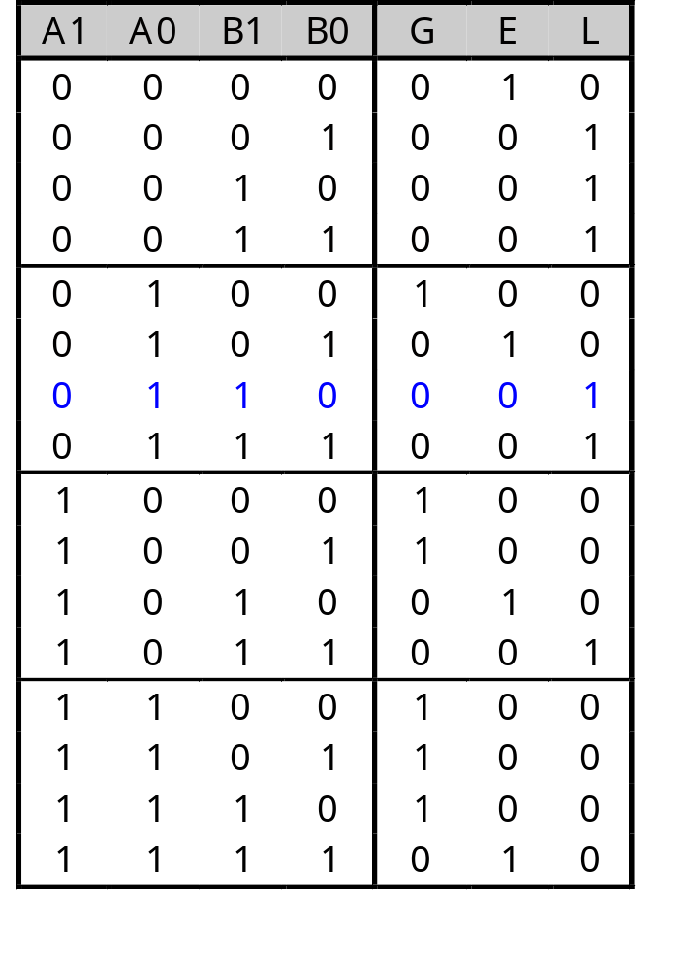
Comparing 2-bit Numbers - Formulation

Slide 11
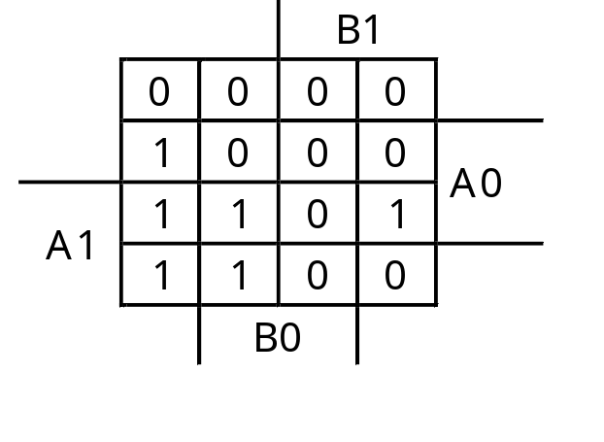
Comparing 2-bit Numbers - Optimization
Let’s use K-maps. There are three functions (each with the same inputs
(A1 A0 B1 B0), so we need three K-maps
G(A1,A0,B1,B0) = A1 A0 B0’ + A0 B1’ B0’ + A1 B1’

Slide 12
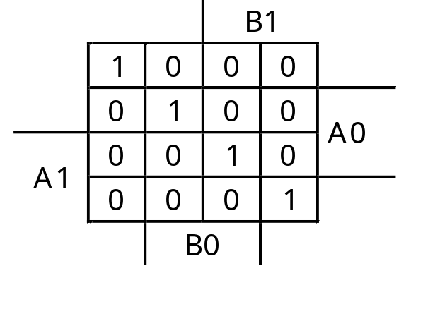
Comparing 2-bit Numbers - Optimization
E(A1,A0,B1,B0) = A1’ A0’ B1’ B0’ + A1’ A0 B1’ B0 + A1 A0 B1 B0 + A1 A0’ B1 B0’

Slide 13
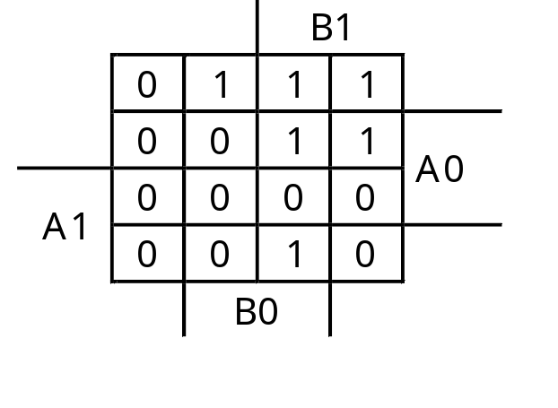
Comparing 2-bit Numbers - Optimization
L(A1,A0,B1,B0) = A1’ A0’ B0 + A0’ B1 B0 + A1’ B1

Slide 14
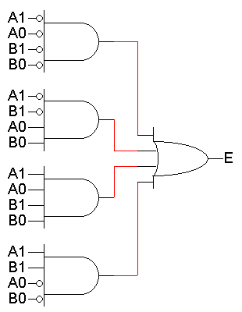
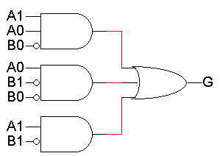
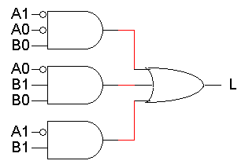
Comparing 2-bit Numbers - Optimization
G = A1 A0 B0’ + A0 B1’ B0’ + A1 B1‘
E = A1’ A0’ B1’ B0’ + A1’ A0 B1’ B0 + A1 A0 B1 B0 + A1A0’ B1 B0‘
L = A1’ A0’ B0 + A0’ B1 B0 + A1’ B1

Slide 15
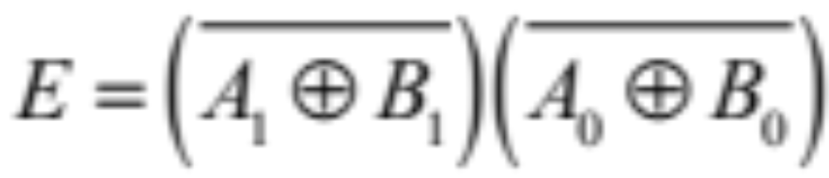
Comparing 2-bit Numbers - Optimization
E = A1’ A0’ B1’ B0’ + A1’ A0 B1’ B0 + A1 A0 B1 B0 + A1A0’ B1 B0‘
You can show,

Slide 16
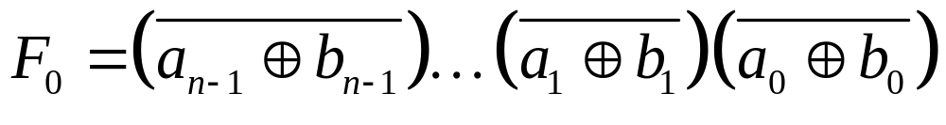
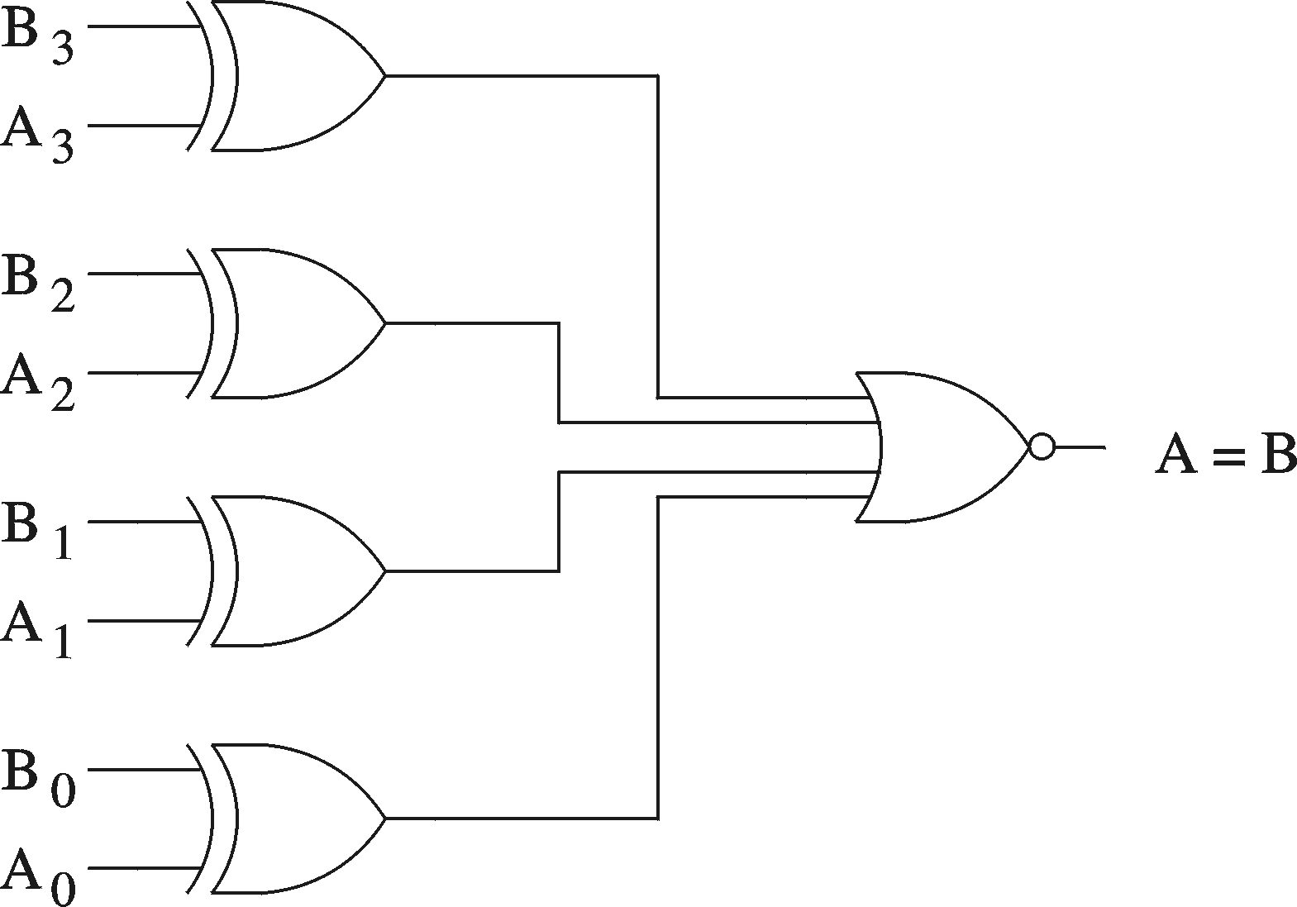
N-bit Equal Comparator

Slide 17
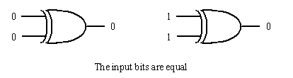
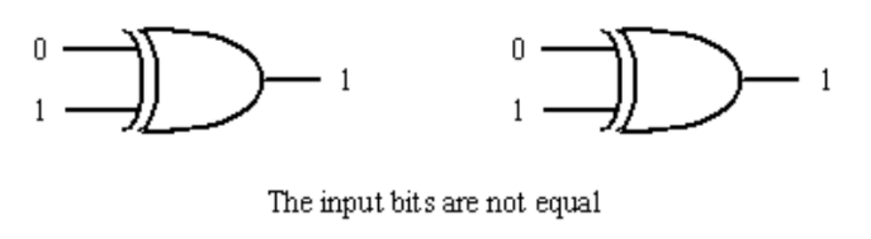
1-bit comparator
If two input bits are not equal, its output is a 1. But if two input bits are equal, its output is a 0.
So exclusive−OR gate can be used as a 2−bit Comparator.

Slide 18
1-bit comparator
Design a logic circuit which will compute
F = (A = B)
X Y Z
0 0 1
0 1 0
1 0 0
1 1 1
X
Z
Y
XNOR

Slide 19
Magnitude Comparator
The comparison of two numbers
  outputs: A>B, A=B, A<B
Design Approaches
  the truth table
    2^{2n} entries - too cumbersome for large n
  use inherent regularity of the problem
    reduce design efforts
    reduce human errors
A < B
A[3..0]
Magnitude
Compare
A = B
B[3..0]
A > B

Slide 20
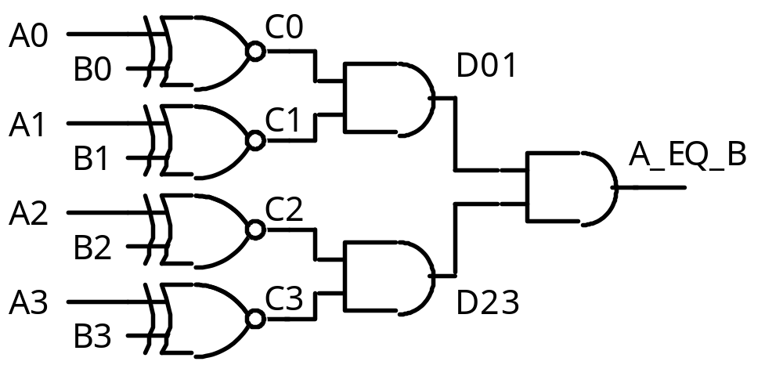
Magnitude Comparator
How can we find A > B?
How many rows would a truth table have?
2⁸ = 256

Slide 21
Magnitude Comparator
Find A > B
Because A3 > B3
i.e. A3 . B3’ = 1
If A =1001 and
B = 0111
is A > B?
Why?
Therefore, one term in the
logic equation for A > B is
A3 . B3’
Notes:
To determine whether A is greater or less than B, we inspect the relative magnitude of pairs of significant digits, starting from the most significant position. If the two digits of a pair are equal, we compare the next lower significant pair of digits, The comparison continues until a pair. of unequal digits is reached. If the corresponding digit of A is I and that of B is 0, we conclude that A > B. If the corresponding digit of A is 0 and that of B is 1, we have A < 3. The sequential comparison can be expressed logically by the two Boolean functions

Slide 22
Magnitude Comparator
If A = 1010 and
B = 1001
is A > B?
Why?
A > B = A3 . B3’
+ C3 . A2 . B2’
+ …..
Because A3 = B3 and
A2 = B2 and
A1 > B1
i.e. C3 = 1 and C2 = 1 and
A1 . B1’ = 1
Therefore, the next term in the
logic equation for A > B is
C3 . C2 . A1 . B1’

Slide 23
Magnitude Comparison
Algorithm -> logic
  A = A₃A₂A₁A₀ ; B = B₃B₂B₁B₀
  A=B if A₃=B₃, A₂=B₂, A₁=B₁and A₁=B₁
Test each bit:
    equality: x_{i}= A_{i}B_{i}+A_{i}'B_{i}'
    (A=B) = x₃x₂x₁x₀
More difficult to test less than/greater than
  (A>B) = A₃B₃'+x₃A₂B₂'+x₃x₂A₁B₁'+x₃x₂x₁ A₀B₀'
  (A<B) = A₃'B₃+x₃A₂'B₂+x₃x₂A₁'B₁+x₃x₂x₁ A₀'B₀
  Start comparisons from high-order bits
Implementation
  x_{i} = (A_{i}B_{i}'+A_{i}'B_{i})’

Slide 24
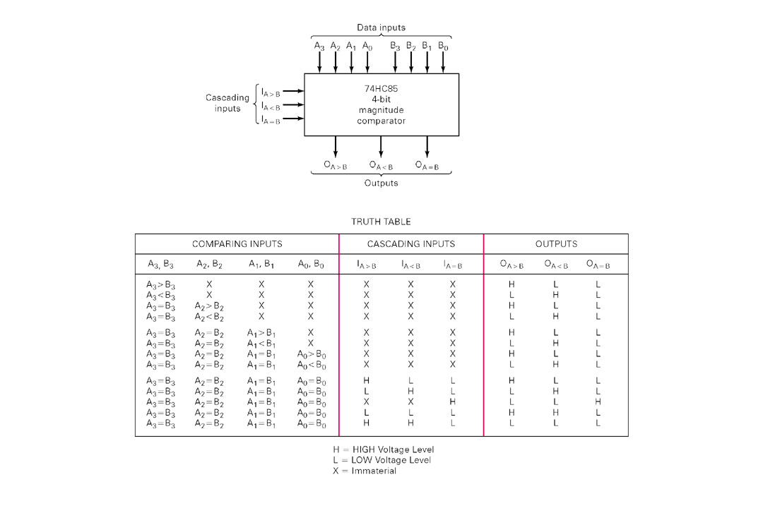
Magnitude Comparison
Hardware chips

Slide 25
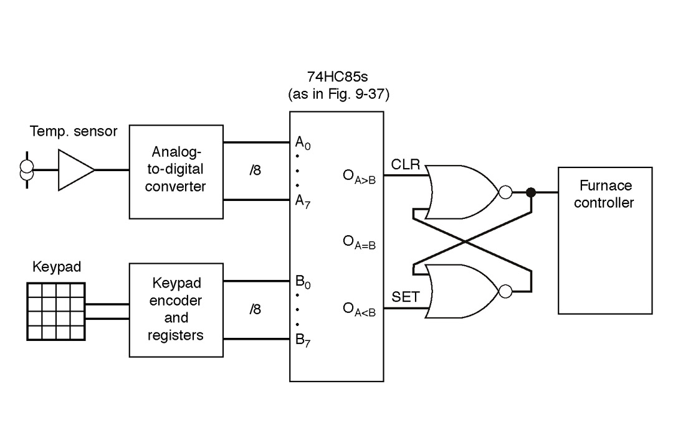
Magnitude Comparator
Real-world application
  Thermostat controller

Slide 26
Multiplexers (Data Selectors)
A multiplexer (MUX) is a device that allows several low-speed signals to be sent over one high-speed output line.
“Select lines” are used to specify which input signal is sent to the output.
A demultiplexer (DEMUX) performs the opposite task as the multiplexer: it divides one high-speed input signal into several low-speed components.
Multiplexers and demultiplexers must be synchronized so that the proper signals are selected.
This type of multiplexing is referred to as time-division multiplexing (TDM). Another type of multiplexing is frequency-division multiplexing (FDM)
Multiplexed signals are typically transmitted in precisely organized manners according to a set of rules for transmission called a protocol.

Slide 27
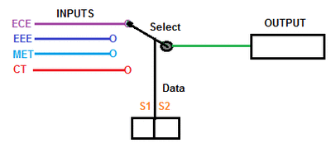
Multiplexers
A multiplexer has
  N control inputs
  2^{N} data inputs
  1 output
A multiplexer routes (or connects) the selected data input to the output.
  The value of the control inputs determines the data input that is selected.

Slide 28
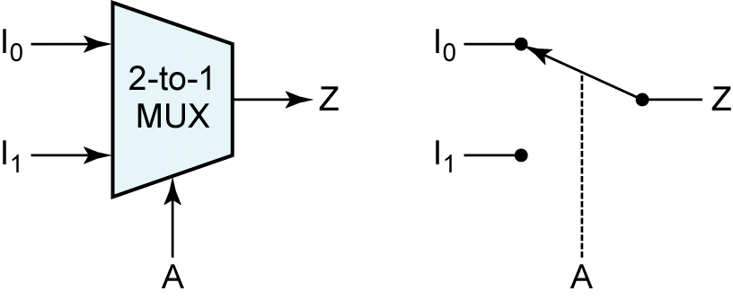
Multiplexers
Data
inputs
Z = A′.I₀ + A.I₁
Control
input

Slide 29
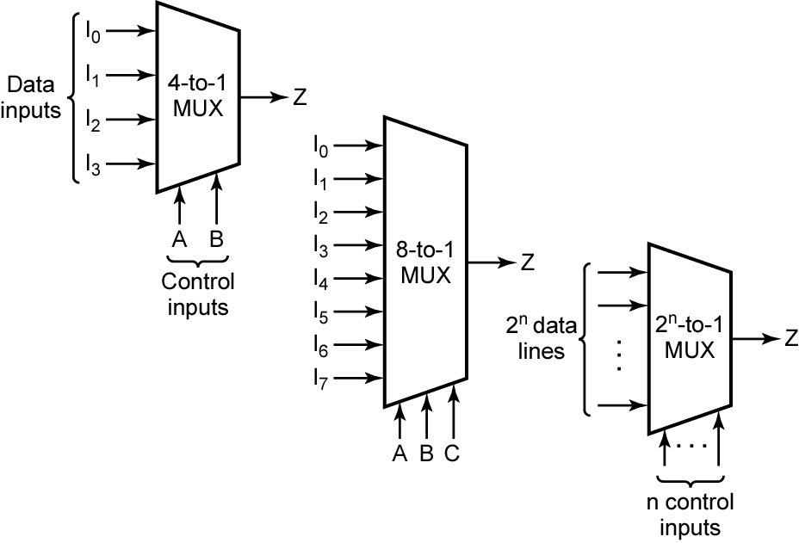
Multiplexers
A | B | F
0 | 0 | I₀
0 | 1 | I₁
1 | 0 | I₂
1 | 1 | I₃
MSB
LSB
Z = A′.B'.I₀ + A'.B.I₁ + A.B'.I₂ + A.B.I₃

Slide 30
Multiplexers
A | B | C | F
0 | 0 | 0 | I₀
0 | 0 | 1 | I₁
0 | 1 | 0 | I₂
0 | 1 | 1 | I₃
1 | 0 | 0 | I₄
1 | 0 | 1 | I₅
1 | 1 | 0 | I₆
1 | 1 | 1 | I₇
MSB
LSB
Z = A′.B'.C'.I₀ + A'.B'.C.I₁ + A'.B.C'.I₂ + A'.B.C.I₃ +
A.B'.C'.I₀ + A.B'.C.I₁ + A'.B.C'.I₂ + A.B.C.I₃

Slide 31
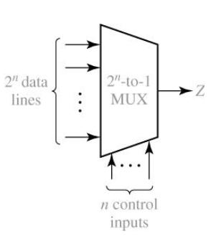
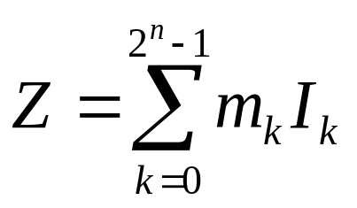
Multiplexers
Logic equation for the 2^{n}-to-1 MUX

Slide 32
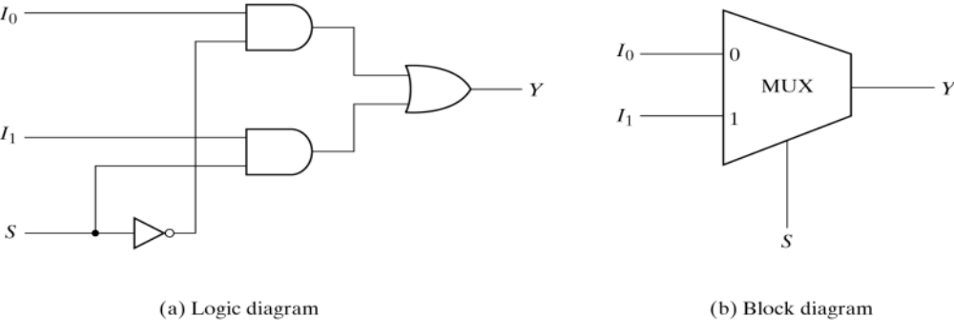
Multiplexers
A multiplexer (MUX) selects one data line from two or more input lines and routes data from the selected line to the output. The particular data line that is selected is determined by the select inputs.
Select an input value with one or more select bits
Use for transmitting data
Allows for conditional transfer of data
Sometimes called a mux

Slide 33
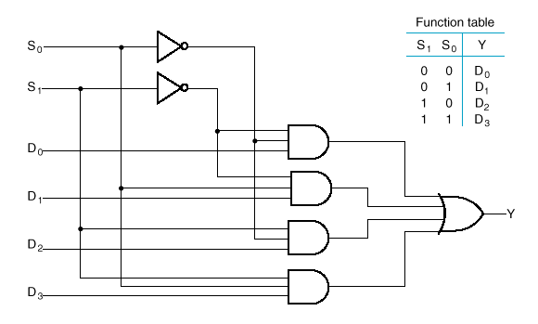
4– to– 1- Line Multiplexer

Slide 34
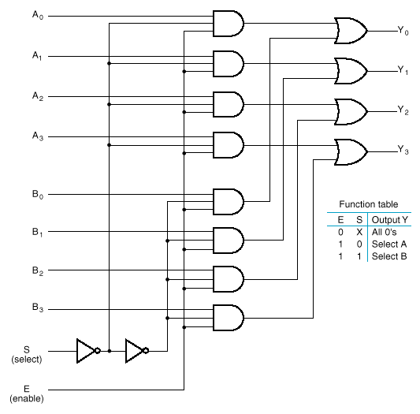
Quadruple 2–to–1-Line Multiplexer
Notice enable bit
Notice select bit
4 bit inputs

Slide 35
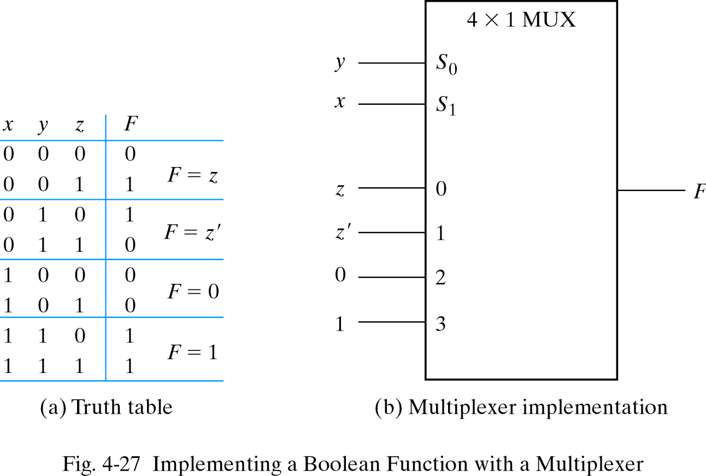
Multiplexer as combinational modules
Connect input variables to select inputs of multiplexer (n-1 for n variables)
Set data inputs to multiplexer equal to values of function for corresponding assignment of select variables
Using a variable at data inputs reduces size of the multiplexer

Slide 36
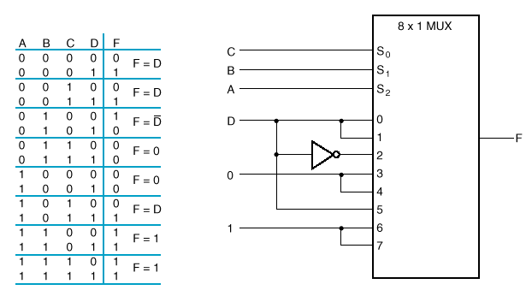
Implementing a Four- Input Function with a Multiplexer

Slide 37
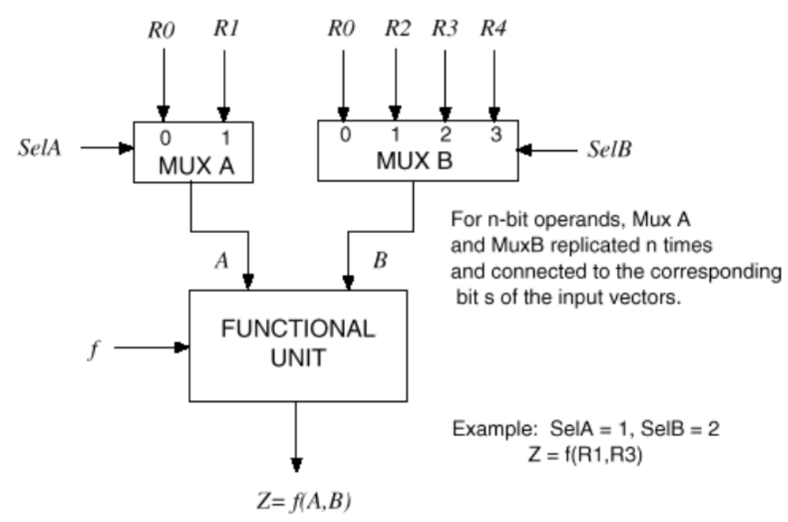
Typical multiplexer uses

Slide 38
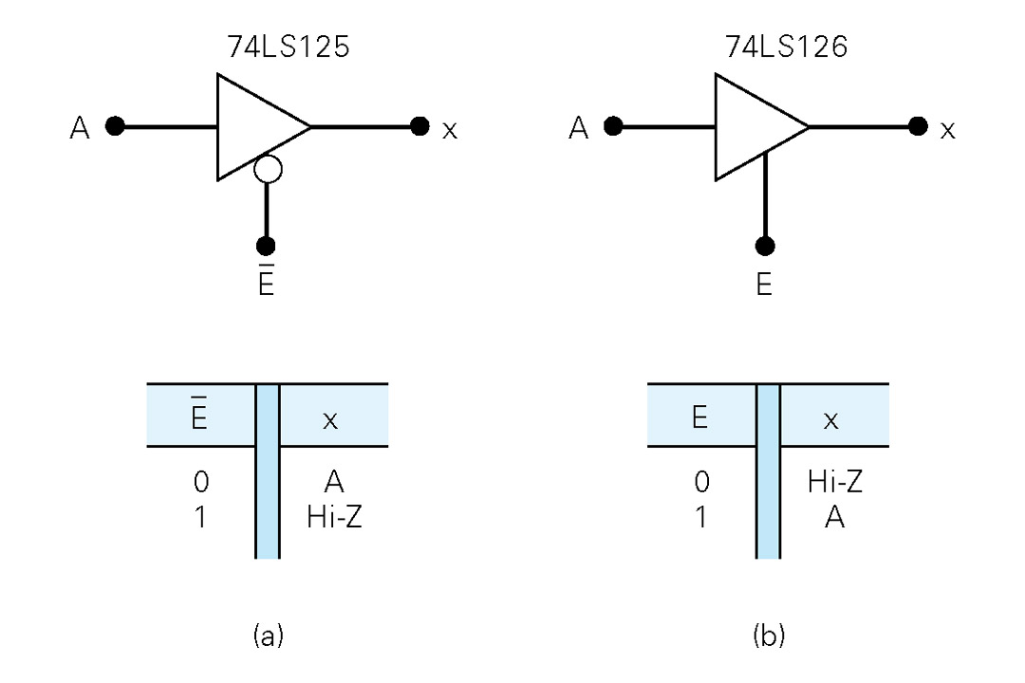
Three-state gates
  A multiplexer can be constructed with three-state gates
  Output state: 0, 1, and high-impedance (open ckts)
  If the select input (E) is 0, the three-state gate has no output
Opposite true here,
No output if E is 1
Notes:
A multiplexer can be constructed with the three state gates digital circuits that exhibit three states. Two of the states are signals equivalent to logic 1 and logic 0 as in a conventional gate. The
third state is a high-impedance state in which (1) the logic behaves like an open circuit, which means that the output appears to be disconnected, (2) the circuit has no logic significance , and (3) the circuit connected to the output of the three-state gate is not affected by the inputs to the gate. Three-state gates may perform any conventional logic such; AND or NAND. However, the one most commonly used is the buffer gate

Slide 39
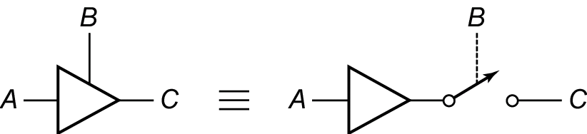
Three-State Buffers
3-State buffer makes use of the output of two or more gates or other logic devices can be connected to each other.
Enable Signal B = 1 the output C = A
Enable Signal B = 0 the output C = Open

Slide 40
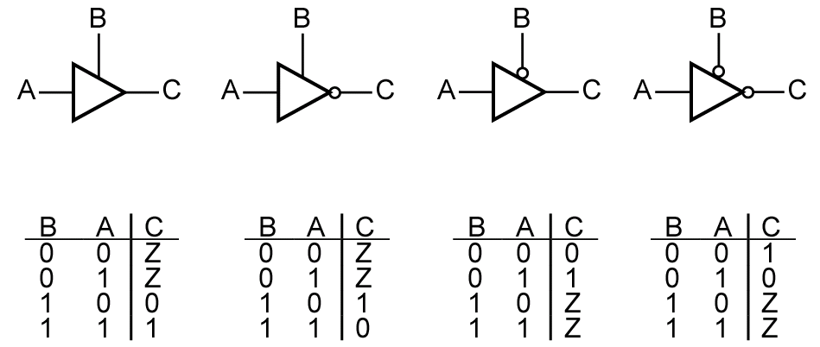
Three-State Buffers
Four kinds of three-state buffers
Can not operate: Output = Z
Unclear output: Output = X
(a)
(b)
(c)
(d)

Slide 41
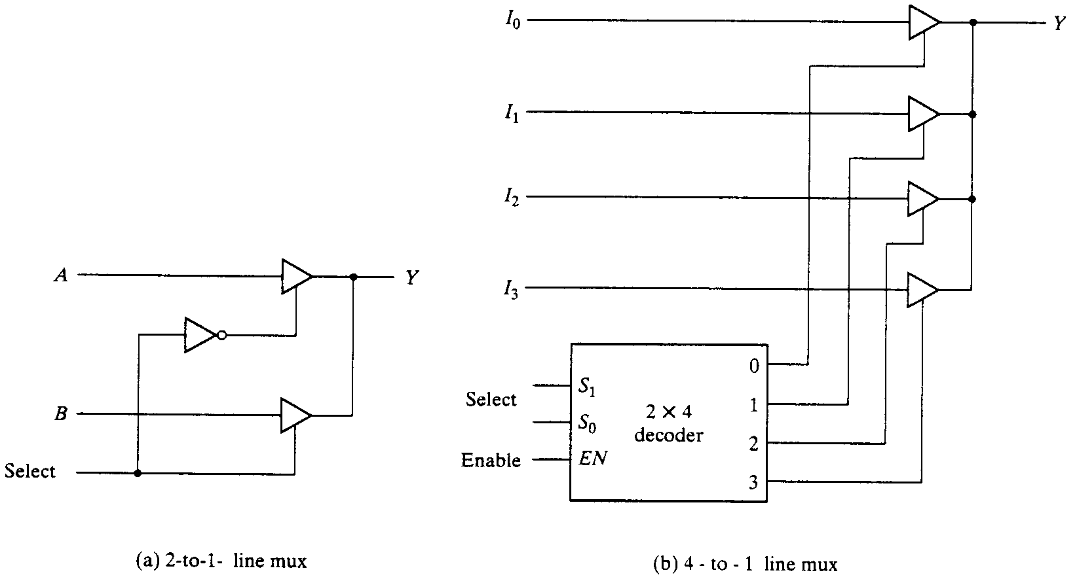
Three-state gates
  A multiplexer can be constructed with three-state gates
  Output state: 0, 1, and high-impedance (open ckts)
  If the select input is low, the three-state gate has no output

Slide 42
Summary
Magnitude comparators allow for data comparison
  Can be built using and-or gates
Greater/less than requires more hardware than equality
Multiplexers are fundamental digital components
  Can be used for logic
  Useful for datapaths
  Scalable
Tristate buffers have three types of outputs
  0, 1, high-impedence (Z)
  Useful for datapaths
Notes:
credential:
bring a computer
die photo
wafer
:
This can be an hidden slide. I just want to use this to do my own planning.
I have rearranged Culler’s lecture slides slightly and add more slides. This covers everything he covers in his first lecture (and more) but may
We will save the fun part, “ Levels of Organization,” at the end (so student can stay awake): I will show the internal stricture of the SS10/20.
Notes to Patterson: You may want to edit the slides in your section or add extra slides to taylor your needs.

